Slide 1
Architecture Design
Preeti Mishra
Course Instructor

Slide 2
Definitions
The software architecture of a program or computing system is the structure or structures of the system which comprise
  The software components
  The externally visible properties of those components
  The relationships among the components
Software architectural design represents the structure of the data and program components that are required to build a computer-based system
An architectural design model is transferable
  It can be applied to the design of other systems
  It represents a set of abstractions that enable software engineers to describe architecture in predictable ways

Slide 3
Why Architecture?
The architecture is not the operational software. Rather, it is a representation that enables a software engineer to:
(1) analyze the effectiveness of the design in meeting its stated requirements,
(2) consider architectural alternatives at a stage when making design changes is still relatively easy, and
(3) reduce the risks associated with the construction of the software.

Slide 4
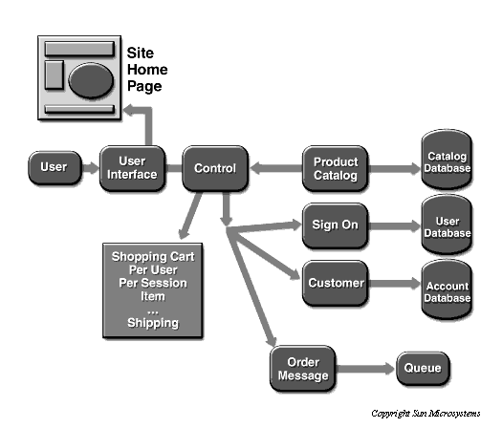

Slide 5
Why is Architecture Important?
Representations of software architecture are an enabler for communication between all parties (stakeholders) interested in the development of a computer-based system.
The architecture highlights early design decisions that will have a profound impact on all software engineering work that follows and, as important, on the ultimate success of the system as an operational entity.
Architecture “constitutes a relatively small, intellectually graspable mode of how the system is structured and how its components work together”

Slide 6
Architectural Descriptions
The IEEE Computer Society has proposed IEEE-Std-1471-2000, Recommended Practice for Architectural Description of Software-Intensive System, [IEE00]
  to establish a conceptual framework and vocabulary for use during the design of software architecture,
  to provide detailed guidelines for representing an architectural description, and
  to encourage sound architectural design practices.
The IEEE Standard defines an architectural description (AD) as a “a collection of products to document an architecture.”
  The description itself is represented using multiple views, where each view is “a representation of a whole system from the perspective of a related set of [stakeholder] concerns.”

Slide 7
Architectural Design Process
Basic Steps
  Creation of the data design
  Derivation of one or more representations of the architectural structure of the system
  Analysis of alternative architectural styles to choose the one best suited to customer requirements and quality attributes
  Elaboration of the architecture based on the selected architectural style
A database designer creates the data architecture for a system to represent the data components
A system architect selects an appropriate architectural style derived during system engineering and software requirements analysis

Slide 8
Emphasis on Software Components
A software architecture enables a software engineer to
  Analyze the effectiveness of the design in meeting its stated requirements
  Consider architectural alternatives at a stage when making design changes is still relatively easy
  Reduce the risks associated with the construction of the software
Focus is placed on the software component
  A program module
  An object-oriented class
  A database
  Middleware

Slide 9
Data Design

Slide 10
Purpose of Data Design
Data design translates data objects defined as part of the analysis model into
  Data structures at the software component level
  A possible database architecture at the application level
It focuses on the representation of data structures that are directly accessed by one or more software components
The challenge is to store and retrieve the data in such way that useful information can be extracted from the data environment
"Data quality is the difference between a data warehouse and a data garbage dump"

Slide 11
Data Design Principles
The systematic analysis principles that are applied to function and behavior should also be applied to data
All data structures and the operations to be performed on each one should be identified
A mechanism for defining the content of each data object should be established and used to define both data and the operations applied to it
Low-level data design decisions should be deferred until late in the design process
The representation of a data structure should be known only to those modules that must make direct use of the data contained within the structure
A library of useful data structures and the operations that may be applied to them should be developed
A software programming language should support the specification and realization of abstract data types

Slide 12
Software Architectural Styles

Slide 13
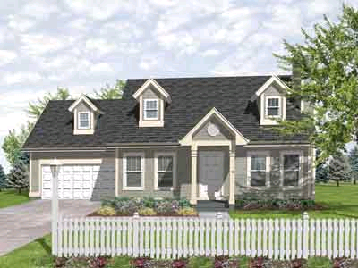
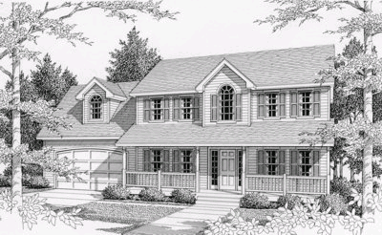
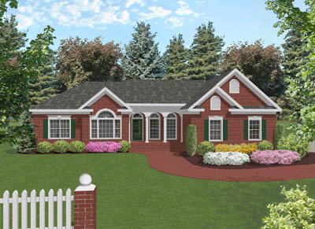
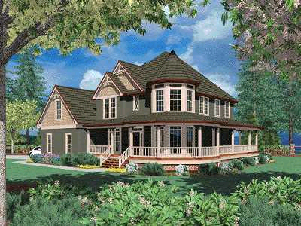
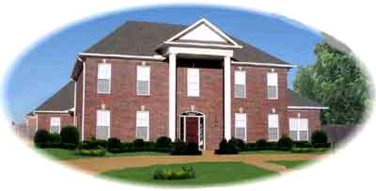
Common Architectural Styles of American Homes

Slide 14
Architectural Styles
Each style describes a system category that encompasses:
(1) a set of components (e.g., a database, computational modules) that perform a function required by a system,
(2) a set of connectors that enable “communication, coordination and cooperation” among components,
(3) constraints that define how components can be integrated to form the system,
(4) semantic models that enable a designer to understand the overall properties of a system by analyzing the known properties of its constituent parts.
Data-centered architectures
Data flow architectures
Call and return architectures
Object-oriented architectures
Layered architectures

Slide 15
Software Architectural Style
The software that is built for computer-based systems exhibit one of many architectural styles
Each style describes a system category that encompasses
  A set of component types that perform a function required by the system
  A set of connectors (subroutine call, remote procedure call, data stream, socket) that enable communication, coordination, and cooperation among components
  Semantic constraints that define how components can be integrated to form the system
  A topological layout of the components indicating their runtime interrelationships

Slide 16
A Taxonomy of Architectural Styles
Independent Components
Communicating
Processes
Event Systems
Implicit
Invocation
Explicit
Invocation
Client/Server
Peer-to-Peer
Data Flow
Data-Centered
Batch Sequential
Pipe and
Filter
Repository
Blackboard
Virtual Machine
Call and Return
Main Program
and Subroutine
Object
Oriented
Layered
Interpreter
Rule-Based
System
Remote Procedure Call

Slide 17
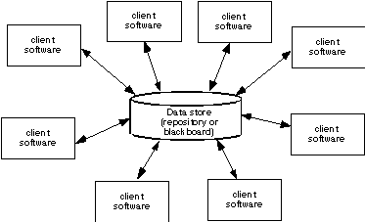
Data-Centered Architecture

Slide 18
Data Flow Style
Validate
Sort
Update
Report

Slide 19
Data Flow Style
Has the goal of modifiability
Characterized by viewing the system as a series of transformations on successive pieces of input data
Data enters the system and then flows through the components one at a time until they are assigned to output or a data store
Batch sequential style
  The processing steps are independent components
  Each step runs to completion before the next step begins
Pipe-and-filter style
  Emphasizes the incremental transformation of data by successive components
  The filters incrementally transform the data (entering and exiting via streams)
  The filters use little contextual information and retain no state between instantiations
  The pipes are stateless and simply exist to move data between filters

Slide 20
Data Flow Style (continued)
Advantages
  Has a simplistic design in the limited ways in which the components interact with the environment
  Consists of no more and no less than the construction of its parts
  Simplifies reuse and maintenance
  Is easily made into a parallel or distributed execution in order to enhance system performance
Disadvantages
  Implicitly encourages a batch mentality so interactive applications are difficult to create in this style
  Ordering of filters can be difficult to maintain so the filters cannot cooperatively interact to solve a problem
  Exhibits poor performance
    Filters typically force the least common denominator of data representation (usually ASCII stream)
    Filter may need unlimited buffers if they cannot start producing output until they receive all of the input
    Each filter operates as a separate process or procedure call, thus incurring overhead in set-up and take-down time

Slide 21
Data Flow Style (continued)
Use this style when it makes sense to view your system as one that produces a well-defined easily identified output
  The output should be a direct result of sequentially transforming a well-defined easily identified input in a time-independent fashion

Slide 22
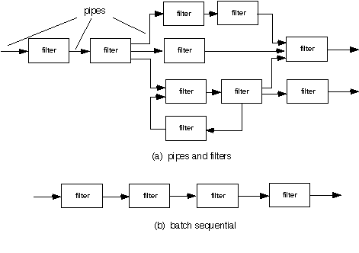
Data Flow Architecture

Slide 23
Call-and-Return Style
Has the goal of modifiability and scalability
Has been the dominant architecture since the start of software development
Main program and subroutine style
  Decomposes a program hierarchically into small pieces (i.e., modules)
  Typically has a single thread of control that travels through various components in the hierarchy
Remote procedure call style
  Consists of main program and subroutine style of system that is decomposed into parts that are resident on computers connected via a network
  Strives to increase performance by distributing the computations and taking advantage of multiple processors
  Incurs a finite communication time between subroutine call and response

Slide 24
Call-and-Return Style (continued)
Object-oriented or abstract data type system
  Emphasizes the bundling of data and how to manipulate and access data
  Keeps the internal data representation hidden and allows access to the object only through provided operations
  Permits inheritance and polymorphism
Layered system
  Assigns components to layers in order to control inter-component interaction
  Only allows a layer to communicate with its immediate neighbor
  Assigns core functionality such as hardware interfacing or system kernel operations to the lowest layer
  Builds each successive layer on its predecessor, hiding the lower layer and providing services for the upper layer
  Is compromised by layer bridging that skips one or more layers to improve runtime performance
Use this style when the order of computation is fixed, when interfaces are specific, and when components can make no useful progress while awaiting the results of request to other components

Slide 25
Call-and-Return Style
Main module
Subroutine B
Subroutine A
Subroutine A-1
Subroutine A-2
Application layer
Class V
Class W
Transport layer
Network layer
Class X
Class Y
Data layer
Class Z
Physical layer

Slide 26
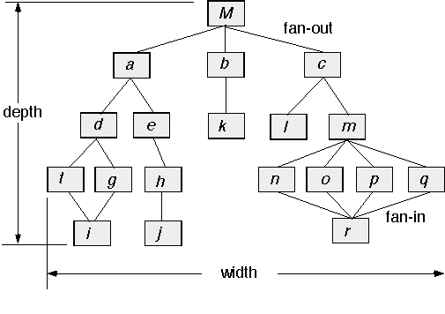
Call and Return Architecture

Slide 27
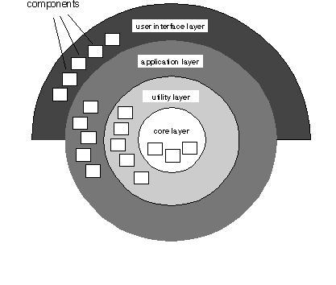
Layered Architecture

Slide 28
Architectural Patterns
Concurrency—applications must handle multiple tasks in a manner that simulates parallelism
  operating system process management pattern
  task scheduler pattern
Persistence—Data persists if it survives past the execution of the process that created it. Two patterns are common:
  a database management system pattern that applies the storage and retrieval capability of a DBMS to the application architecture
  an application level persistence pattern that builds persistence features into the application architecture
Distribution— the manner in which systems or components within systems communicate with one another in a distributed environment
  A broker acts as a ‘middle-man’ between the client component and a server component.

Slide 29
Architectural Design
The software must be placed into context
  the design should define the external entities (other systems, devices, people) that the software interacts with and the nature of the interaction
A set of architectural archetypes should be identified
  An archetype is an abstraction (similar to a class) that represents one element of system behavior
The designer specifies the structure of the system by defining and refining software components that implement each archetype

Slide 30
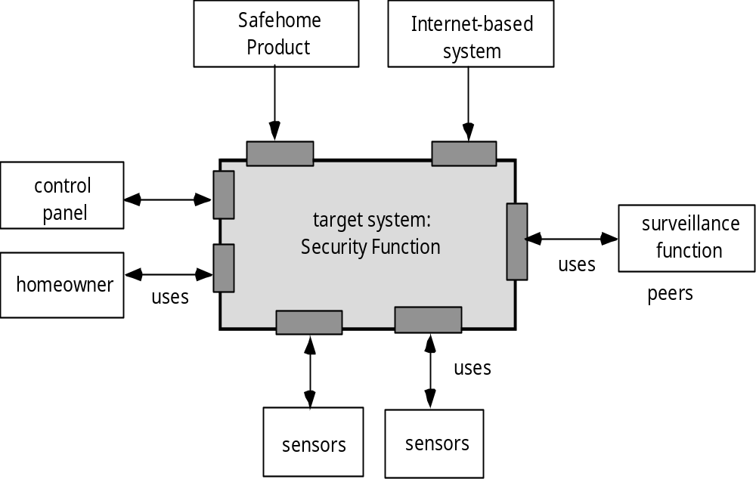
Architectural Context

Slide 31
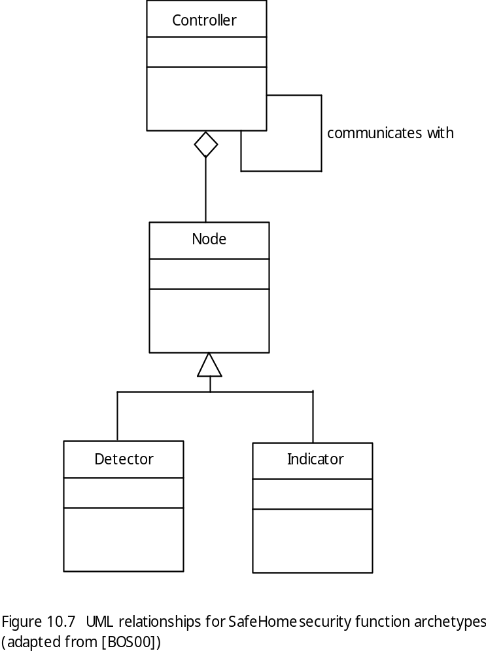
Archetypes

Slide 32
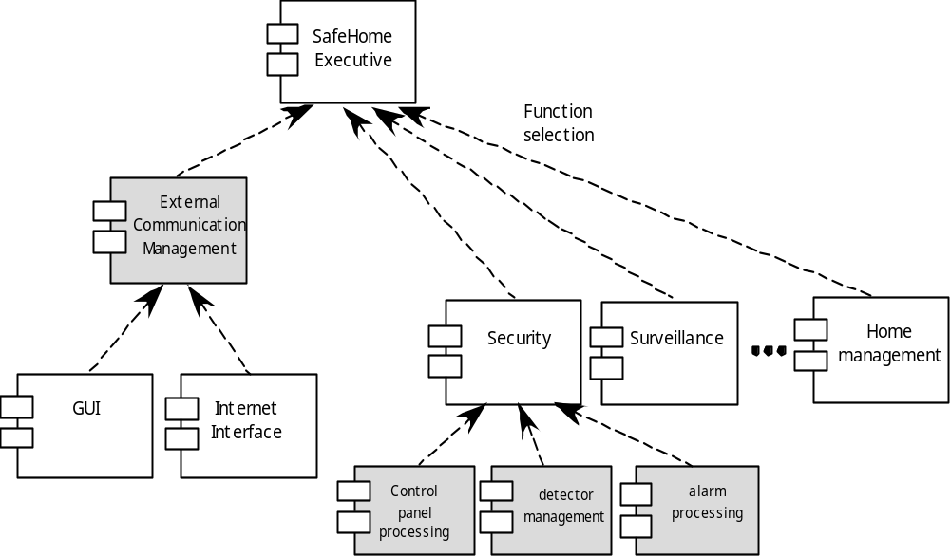
Component Structure

Slide 33
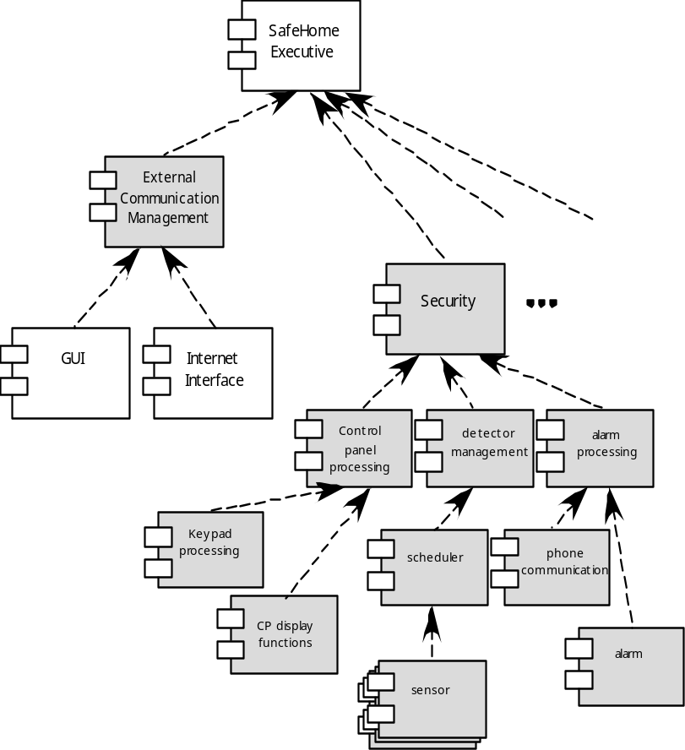
Refined Component Structure

Slide 34
Analyzing Architectural Design
1. Collect scenarios.
2. Elicit requirements, constraints, and environment description.
3. Describe the architectural styles/patterns that have been chosen to address the scenarios and requirements:
• module view
• process view
• data flow view
4. Evaluate quality attributes by considered each attribute in isolation.
5. Identify the sensitivity of quality attributes to various architectural attributes for a specific architectural style.
6. Critique candidate architectures (developed in step 3) using the sensitivity analysis conducted in step 5.

Slide 35
Architectural Complexity
the overall complexity of a proposed architecture is assessed by considering the dependencies between components within the architecture [Zha98]
  Sharing dependencies represent dependence relationships among consumers who use the same resource or producers who produce for the same consumers.
  Flow dependencies represent dependence relationships between producers and consumers of resources.
  Constrained dependencies represent constraints on the relative flow of control among a set of activities.

Slide 36
ADL
Architectural description language (ADL) provides a semantics and syntax for describing a software architecture
Provide the designer with the ability to:
  decompose architectural components
  compose individual components into larger architectural blocks and
  represent interfaces (connection mechanisms) between components.

Slide 37
An Architectural Design Method
customer requirements
"four bedrooms, three baths,
lots of glass ..."
architectural design

Slide 38
Deriving Program Architecture
Program
Architecture

Slide 39
Partitioning the Architecture
“horizontal” and “vertical” partitioning are required

Slide 40
Horizontal Partitioning
define separate branches of the module hierarchy for each major function
use control modules to coordinate communication between functions
function 1
function 3
function 2

Slide 41
Vertical Partitioning: Factoring
design so that decision making and work are stratified
decision making modules should reside at the top of the architecture
decision-makers
workers

Slide 42
Why Partitioned Architecture?
results in software that is easier to test
leads to software that is easier to maintain
results in propagation of fewer side effects
results in software that is easier to extend

Slide 43
Structured Design
objective: to derive a program architecture that is partitioned
approach:
  a DFD is mapped into a program architecture
  the PSPEC and STD are used to indicate the content of each module
notation: structure chart

Slide 44
Flow Characteristics
Transform flow
This edition of SEPA does not cover transaction mapping. For a detailed discussion see the SEPA website
Transaction
flow

Slide 45
General Mapping Approach
isolate incoming and outgoing flow
boundaries; for transaction flows, isolate
the transaction center
working from the boundary outward, map
DFD transforms into corresponding modules
add control modules as required
refine the resultant program structure
using effective modularity concepts

Slide 46
General Mapping Approach
Isolate the transform center by specifying incoming and outgoing flow boundaries
Perform "first-level factoring.”
  The program architecture derived using this mapping results in a top-down distribution of control.
  Factoring leads to a program structure in which top-level components perform decision-making and low-level components perform most input, computation, and output work.
  Middle-level components perform some control and do moderate amounts of work.
Perform "second-level factoring."

Slide 47
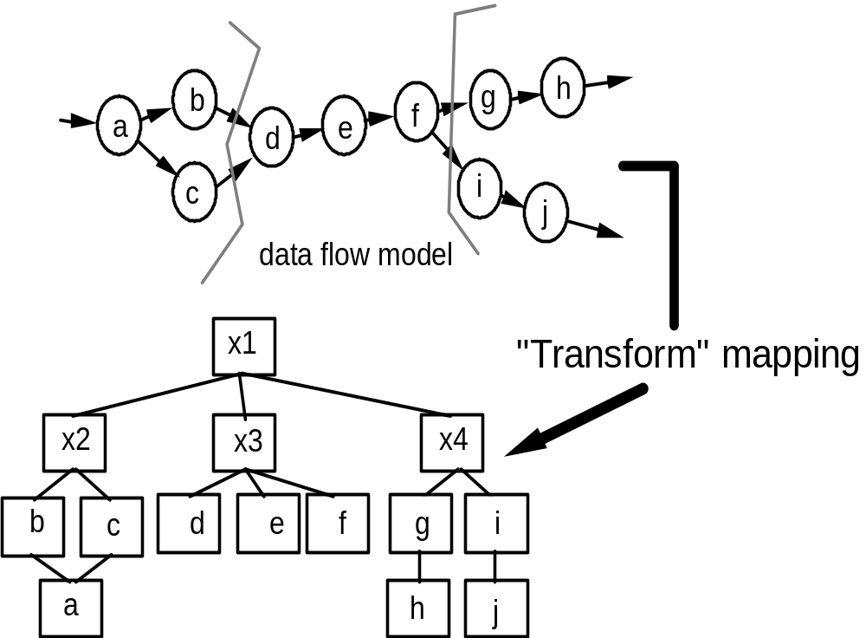
Transform Mapping

Slide 48
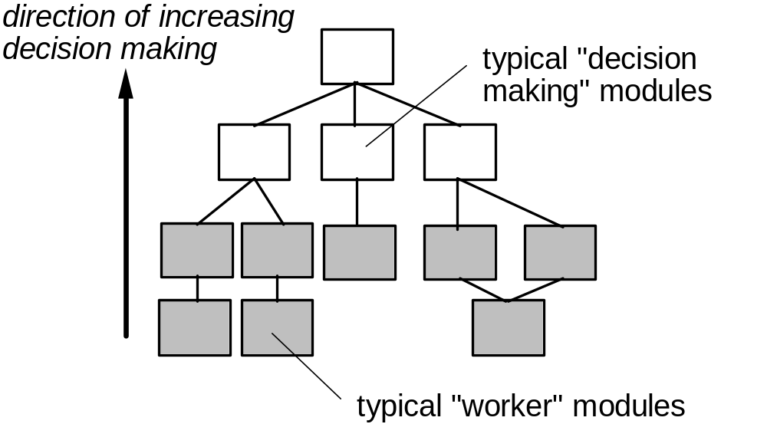
Factoring

Slide 49
First Level Factoring
main
program
controller
input
processing
output
controller
controller
controller

Slide 50
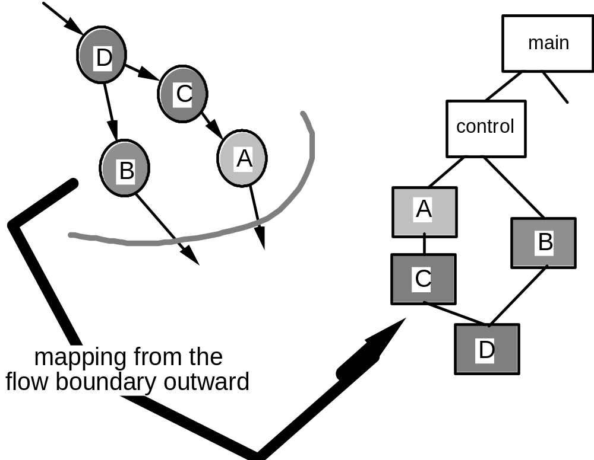
Second Level Mapping

